Slide 1

Name: Farhan Ahmad
Course: B.Tech in Computer Engineering
Technology : Computer Vision
Domain : Health Care
-----------------------------------------------------------------------------------------------
Project Tittle
Disease Recognition Using X-ray plates

Slide 2
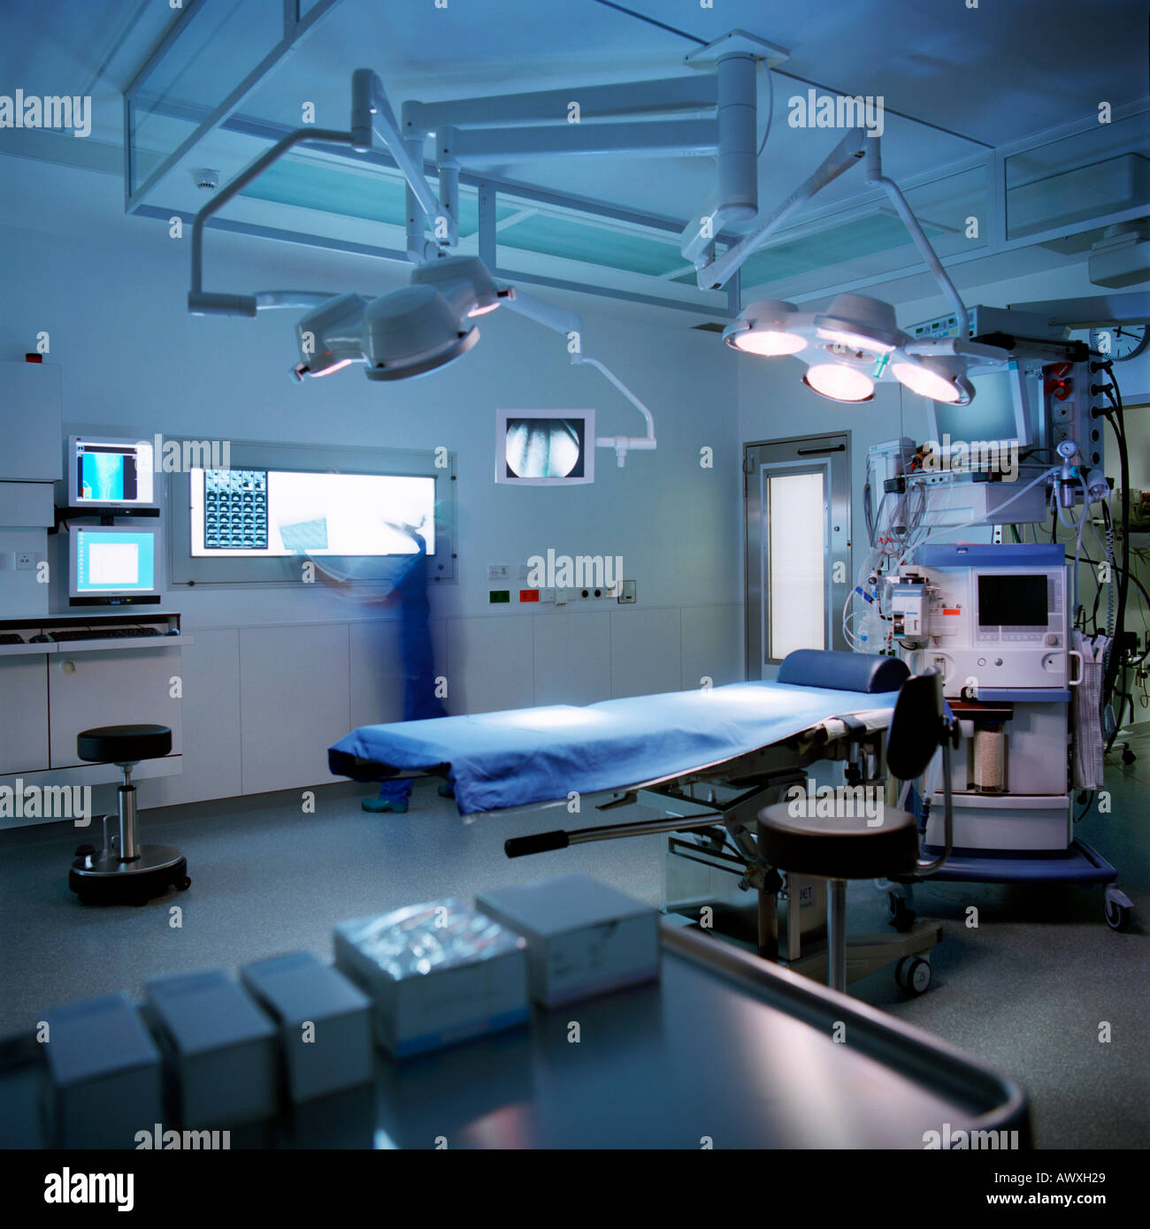
Disease Recognition Using X-ray plates

Slide 3
Project Detail
Project Title | Disease Recognition Using X-ray plates
Technology | Computer Vision
Domain | Health Care
Project Difficulty Level | Advanced
Programming Language Used | Python Programming
Tools used | Jupyter Notebook, AWS,Azure,Github

Slide 4
Objective
An X-ray is a common imaging test that’s been used for decades. It can help your doctor view the inside of your body without having to make an incision. This can help them diagnose, monitor, and treat many medical conditions. Different types of X-rays are used for different purposes. For example, your doctor may order a mammogram to examine your breasts. Or they may order an X-ray with a barium enema to get a closer look at your gastrointestinal tract.
There are some risks involved in getting an X-ray. X-rays are standard procedures. An X-ray technologist or radiologist can perform an X-ray in a hospital’s radiology department, a dentist’s office, or a clinic that specializes in diagnostic procedures.
So, the main objectives are as follows:
Identify or classify the disease through the X-ray plates.
2. Make a clear report of the whole Result. 3. Also suggest nearby doctors and hospital or the mentioned disease using your current location.

Slide 5
Problem Statement
The X-rays are used to examine many parts of our body. Sometimes a human doctor might miss slightest part of disfunctionality. An automated vision based system which is trained with huge amount of data which can recognize the slightest amount of disfunctionality in any part of the body which can be visible through X-ray Plates.

Slide 6







Tools Used

Slide 7
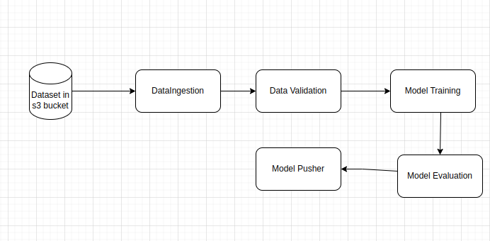
Architecture

Slide 8
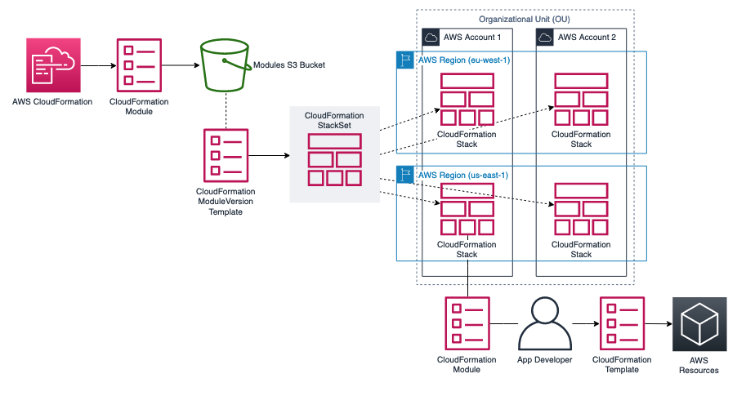
Architecture

Slide 9
KPIs (Key Performance Indicators)
Key indicators displaying a summary of the disease recognition of X-ray plates and its relationship with different metrics
Identify or classify the disease through the X-ray plates
Make a clear report of the whole Result
Also suggest nearby doctors and hospital for the mentioned disease using your current location

Slide 10
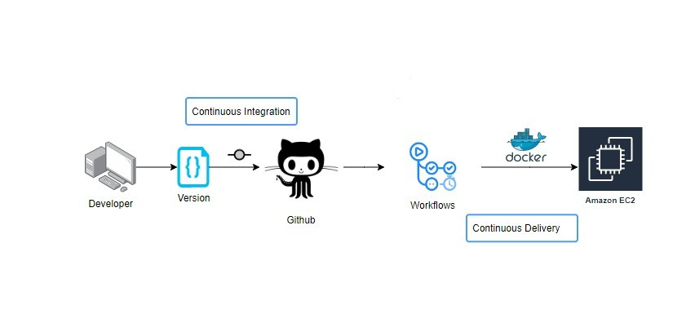
Deployment

Slide 11
Deployment
Amazon EC2 prioritizes choice in flexibility to fit, rather than dictate, your enterprise architecture. AWS and it Service leverage your existing technology investments and integrate them into your IT infrastructure to provide a self-service, modern analytics platform for your users. With on-premises, cloud, and hosted options, there is a version of Power BI to match your requirements

Slide 12
Conclusion
Identify or classify the disease through the X-ray plates
Make a clear report of the whole Result.
Also suggest nearby doctors and hospital for the mentioned disease using your current location

